Slide 1
UofT Engineering Finance Association
Finance 101
Intro
JP Nijjer – Head Analyst

Slide 2

Everyone Loves Dilbert
UTEFA
Introduction
Time Value of Money
Financial Products
Stocks
Conclusion
Notes:
2

Slide 3
How much do you know?
UTEFA
Survey of how much people know…
What is present value
What is a balance sheet
What is an ETF
What is quantitative easing
Introduction
Time Value of Money
Financial Products
Stocks
Conclusion
Notes:
3
How many of you trade?

Slide 4
Intro To The Business
UTEFA
What are capital markets?
A market in which individuals and institutions trade financial securities/instruments.
What makes up capital markets?
Simple viewpoint : Buy Side + Sell Side
Not to be confused with buyers and sellers
Introduction
Time Value of Money
Financial Products
Stocks
Conclusion
Notes:
4
This is probably not the most related to what the club does, but a very important piece of information for anyone wanting to work in capital markets.

Slide 5
Intro To The Business
UTEFA
Buy Side:
Dominated by large institutional investors like Pension Funds, Mutual Funds, Hedge Funds, etc.
Basically identical except for the rules by which they governed
Ultimate goal is to make large returns
Introduction
Time Value of Money
Financial Products
Stocks
Conclusion
Notes:
5
This is probably not the most related to what the club does, but a very important piece of information for anyone wanting to work in capital markets.

Slide 6
Intro To The Business
UTEFA
Sell Side:
Includes sales and trading, research, mostly to facilitate investment banking and often included under the umbrella term of investment banking.
Sales and trading: trading, facilitate interaction with primary and secondary markets
Equity Research: cover individual companies give their opinion to the public (analyst recommendations)
Investment banking: Facilitate financing for large corporations – M&A, IPOs, Debt Issuance
Introduction
Time Value of Money
Financial Products
Stocks
Conclusion
Notes:
6
This is probably not the most related to what the club does, but a very important piece of information for anyone wanting to work in capital markets.

Slide 7
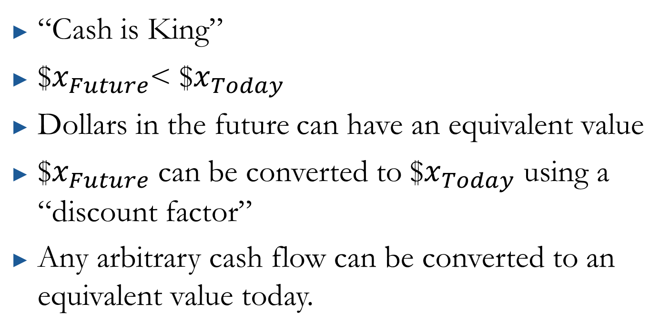
Time Value of Money
UTEFA
“Cash is King”
$$x_{Future}$< $$x_{Today}$
Dollars in the future can have an equivalent value
$$x_{Future}$ can be converted to $$x_{Today}$ using a “discount factor”
Any arbitrary cash flow can be converted to an equivalent value today.
Introduction
Time Value of Money
Financial Products
Stocks
Conclusion
Notes:
7

Slide 8
Time Value of Money
UTEFA
Below is an example of a cash flow (diagram)
(Not to scale)
Cash flow Red and Black are Identical!!
0 1 2 3 4 5 6
Introduction
Time Value of Money
Financial Products
Stocks
Conclusion
Notes:
8

Slide 9
Time Value of Money
UTEFA
This is the concept behind the Discounted Cash Flow Method
A Stock’s current price can be found as a weighted sum of future cash flows
Introduction
Time Value of Money
Financial Products
Stocks
Conclusion
Notes:
9

Slide 10
Financial Products
UTEFA
Example of some types of products:
Stocks – We’ll talk more about this soon
Bonds – Corporate, government
Commodities
Currency
Derivatives – Product whose value is based on another’s: options, swaps, futures,
Introduction
Time Value of Money
Financial Products
Stocks
Conclusion
Notes:
10

Slide 11
Bonds
UTEFA
Typically a very secure investment
Often structured such that you pay an amount now: Price, receive periodic payments: Coupons, and receive a final lump sum: Face Value
Ex: 10 Year US Treasury Notes
Introduction
Time Value of Money
Financial Products
Stocks
Conclusion
Notes:
11

Slide 12
Commodities
UTEFA
Basic tangible goods that are traded in large sums
Typically traded in the futures market (for delivery in the future rather than today)
Ex: Gold, Wheat, Oil, Pork Bellies (until 2011)
Introduction
Time Value of Money
Financial Products
Stocks
Conclusion
Notes:
12
Trading Places

Slide 13
Currency
UTEFA
Largest asset class (by volume traded)
Buying and selling currencies with other currencies leads to exchange rates
Ex: CAD/USD
Introduction
Time Value of Money
Financial Products
Stocks
Conclusion
Notes:
13
Trading Places

Slide 14
Derivatives
UTEFA
Value of the derivative is linked to some underlying item
Can be made incredibly complex with multiple underlying assets, with variable conditions
Often these are created OTC (over the counter) - designed by sales and trading for consumers
Ex: Call option – gives you the right (but not the obligation) to buy a stock at a given strike price at a given date
Introduction
Time Value of Money
Financial Products
Stocks
Conclusion
Notes:
14
Trading Places

Slide 15
Stocks
UTEFA
This is UTEFA’s main focus
A stock basically gives you partial ownership in a company
Ex: 1 share of AAPL gives you ownership of 1/908M of Apple.
Introduction
Time Value of Money
Financial Products
Stocks
Conclusion
Notes:
15
Trading Places

Slide 16
Stocks
UTEFA
Who owns stocks?
Mainly held by large institutional investors
Followed by smaller guys like you and I (retail)
Why own stocks? Can be for many reasons
You support what the company does
Make money (risk adjusted) returns
Need to put your money somewhere
Introduction
Time Value of Money
Financial Products
Stocks
Conclusion
Notes:
16
Trading Places

Slide 17
Stocks
UTEFA
They are available in the primary and secondary markets
Primary: When stocks are issued (like in an initial public offering – IPO)
Secondary: When they are traded amongst one another (like on the TSX)
Introduction
Time Value of Money
Financial Products
Stocks
Conclusion
Notes:
17
Trading Places

Slide 18
Stocks
UTEFA
Buying and Selling MUST occur on an exchange in order to change ownership.
Typically a broker mediates the exchange.
Our broker is Questrade which allows for trading electronically.
Follows a limit order book whereby individuals list prices they are willing to buy/sell at and matching buy/sell prices get executed
Introduction
Time Value of Money
Financial Products
Stocks
Conclusion
Notes:
18
Trading Places

Slide 19
Stocks
UTEFA
How do I pick a stock?
Fundamental Analysis
Technical Analysis
Speculating
(Portfolio optimization)
UTEFA focuses on fundamental analysis based on company financials (we’ll get into accounting next time)
Introduction
Time Value of Money
Financial Products
Stocks
Conclusion
Notes:
19
Trading Places

Slide 20
ETFs
UTEFA
I bring these up because they make up a significant part of the marketplace
Exchange Traded Funds
Diversified set of holdings which follow broad indices like the S&P500
Popular with retail investors who can get diversified exposure to the marketplace without owning 500 stocks
Introduction
Time Value of Money
Financial Products
Stocks
Conclusion
Notes:
20
Trading Places

Slide 21
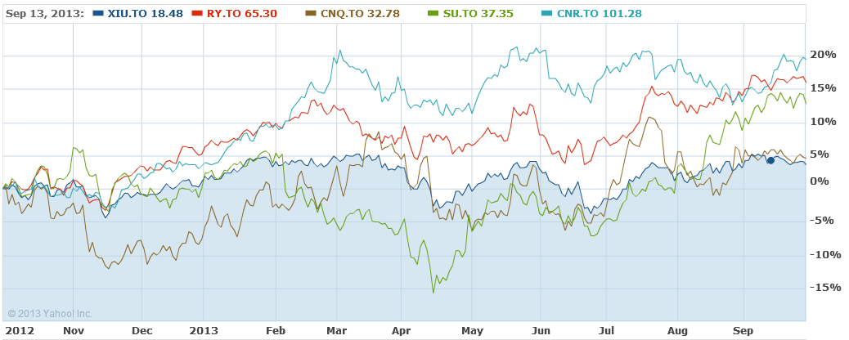
Indices
UTEFA
A fictitious number which follows the “average” group of stocks.
Ex: S&P/TSX60 is a weighted average of the 60 biggest stocks in the Canada
Introduction
Time Value of Money
Financial Products
Stocks
Conclusion
Notes:
21
Trading Places

Slide 22
Useful Websites
UTEFA
Investopedia.com
Morningstar.com
Finance.google.com
Finance.yahoo.com
Bloomberg
(Seekingalpha.com)
Read The News!
Introduction
Time Value of Money
Financial Products
Stocks
Conclusion
Notes:
22
Be weary of opinion based columns, and even the wording of news stories!

Slide 23
Conclusion
UTEFA
The hope was to give you a feel for what is available
I hope you learned something today!
Introduction
Time Value of Money
Financial Products
Stocks
Conclusion
Notes:
23
Trading Places

Slide 24

Questions or Comments?
Notes:
24

